Slide 1
GitHub And Gitkraken

Slide 2
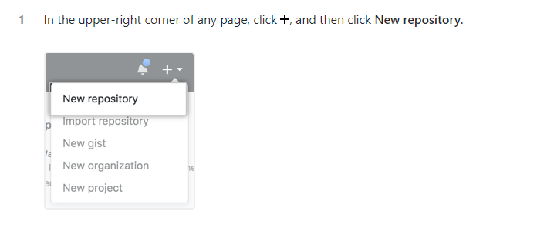
Create a repo

Slide 3
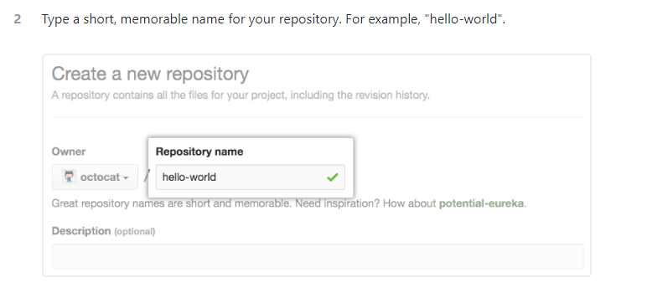

Slide 4
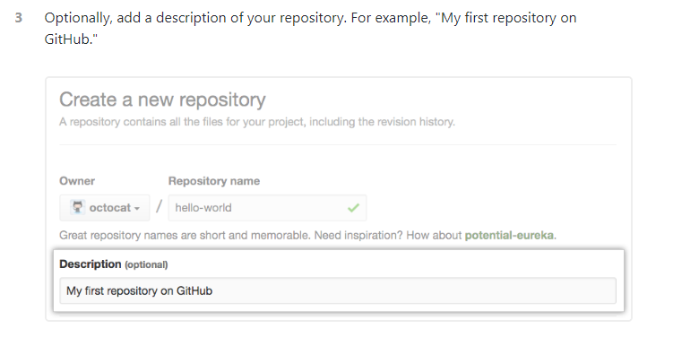

Slide 5
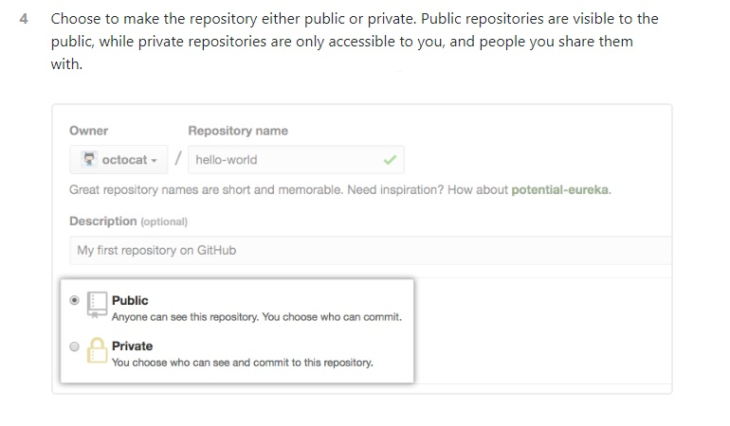

Slide 6
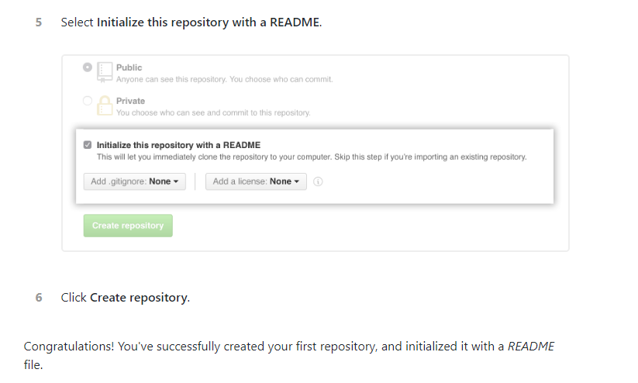

Slide 7
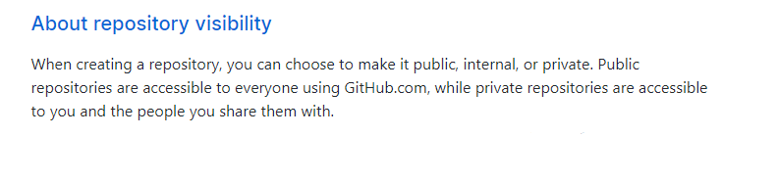
Setting repository visibility

Slide 8
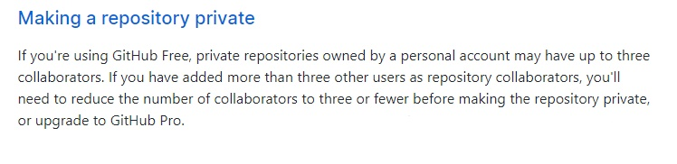

Slide 9
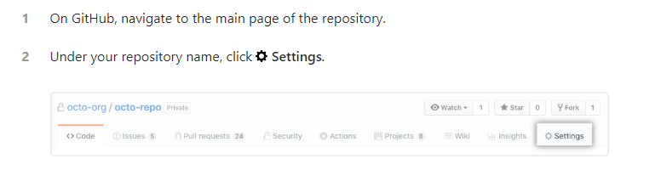

Slide 10
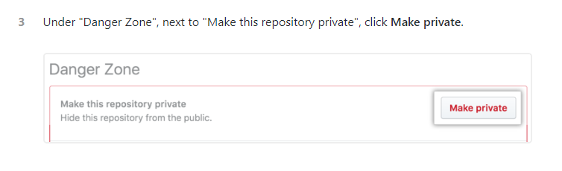

Slide 11
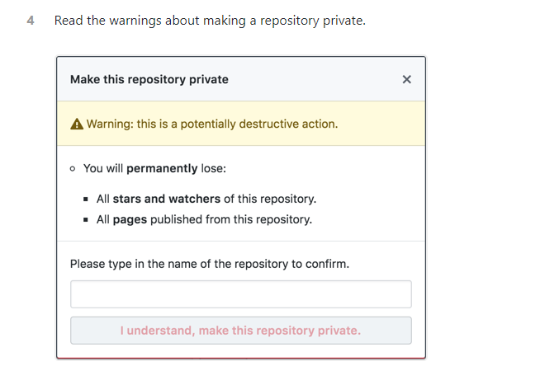

Slide 12
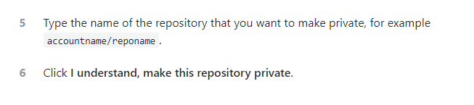

Slide 13
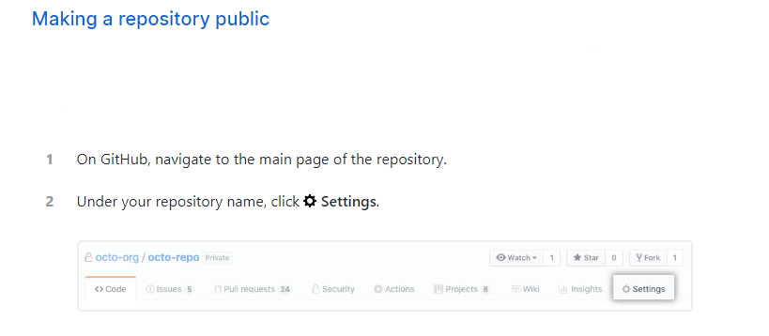

Slide 14
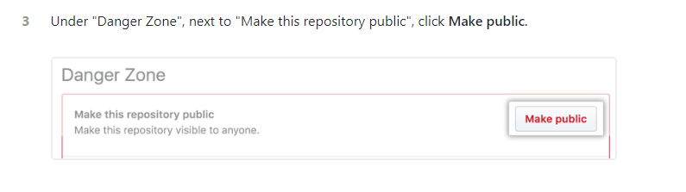

Slide 15
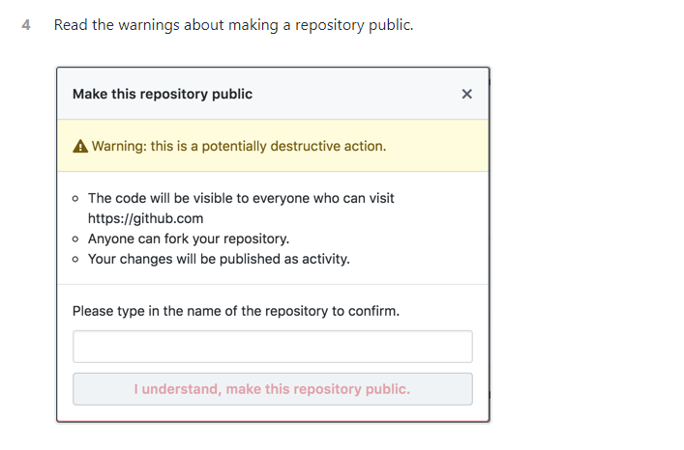

Slide 16
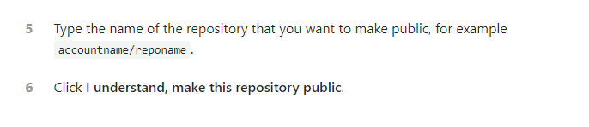

Slide 17
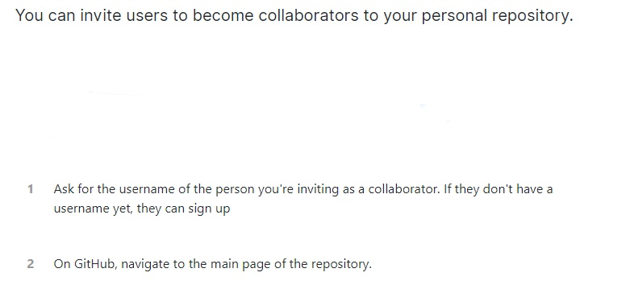
Inviting collaborators to a personal repository

Slide 18
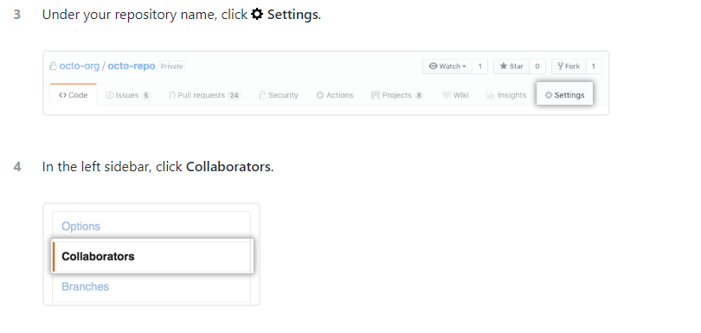

Slide 19
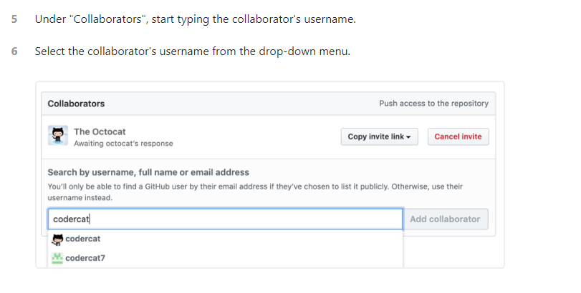

Slide 20
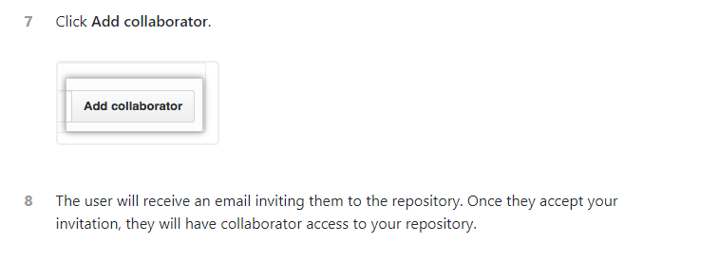

Slide 21
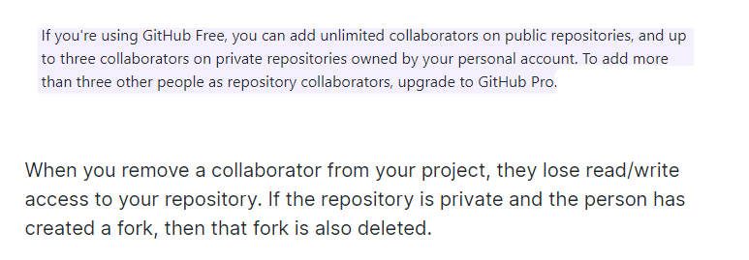
Removing a collaborator from a personal repository

Slide 22
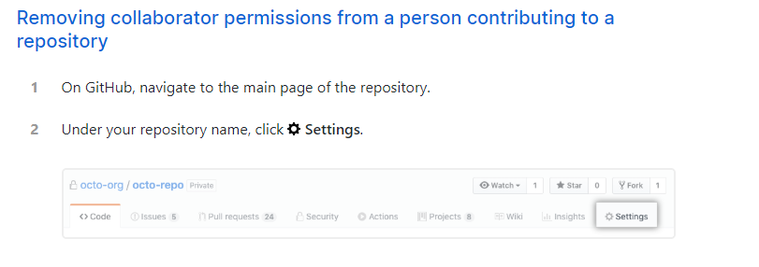

Slide 23
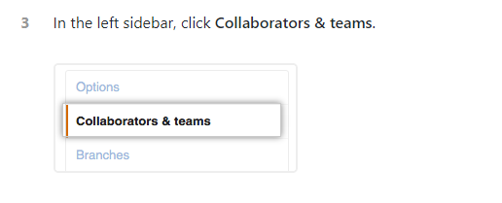

Slide 24
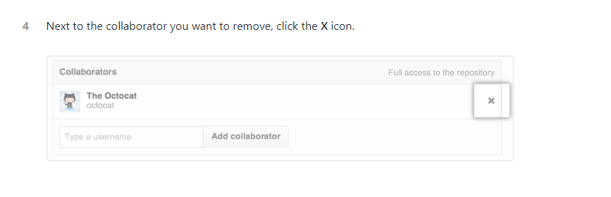

Slide 25
Version control systems
A version control system (often called a source code control system) does these things:
Keeps multiple (older and newer) versions of everything (not just source code)
Requests comments regarding every change
Allows “check in” and “check out” of files so you know which files someone else is working on
Displays differences between versions

Slide 26
Benefits of version control
For working by yourself:
Gives you a “time machine” for going back to earlier versions
Gives you great support for different versions (standalone, web app, etc.) of the same basic project
For working with others:
Greatly simplifies concurrent work, merging changes

Slide 27
What are Git and GitHub
Git is a free and open source distributed version control system designed to handle everything from small to very large projects with speed and efficiency
GitHub is a web-based Git repository hosting service, which offers all of the distributed revision control and source code management (SCM) functionality of Git as well as adding its own features.

Slide 28
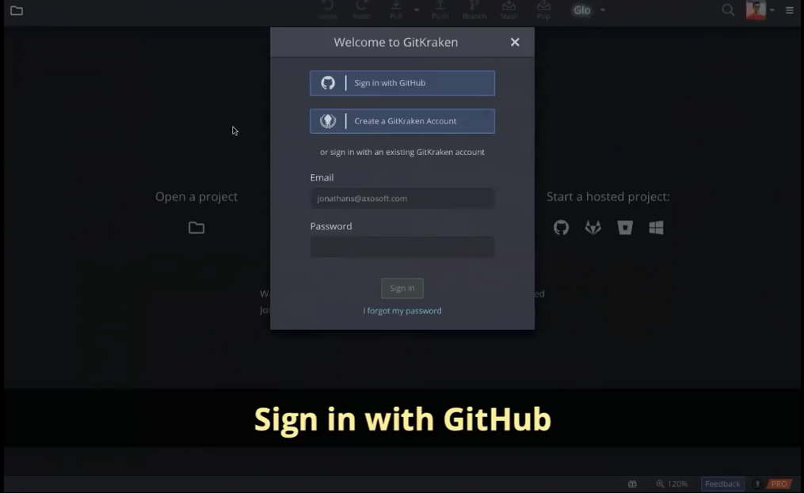
Gitkraken

Slide 29
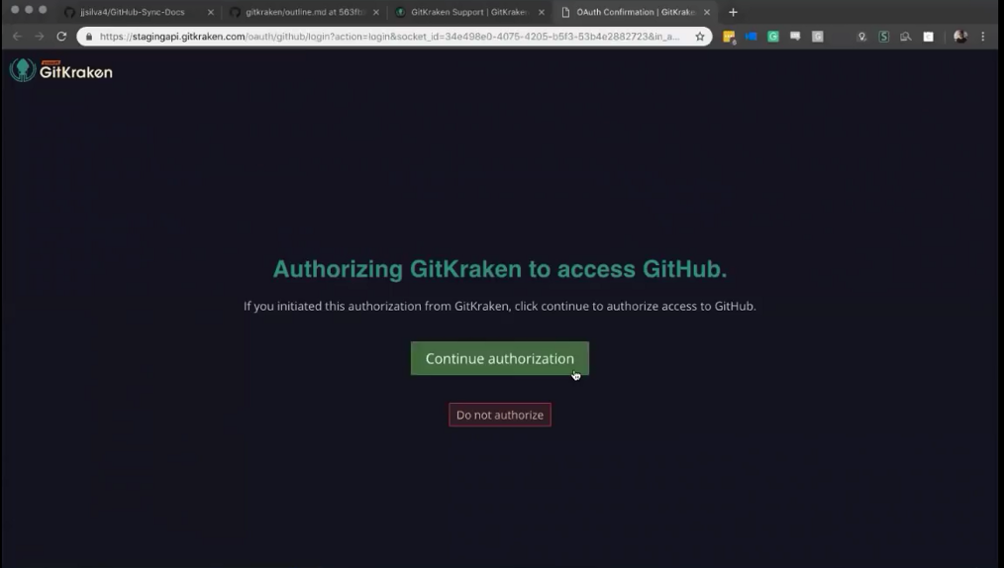

Slide 30
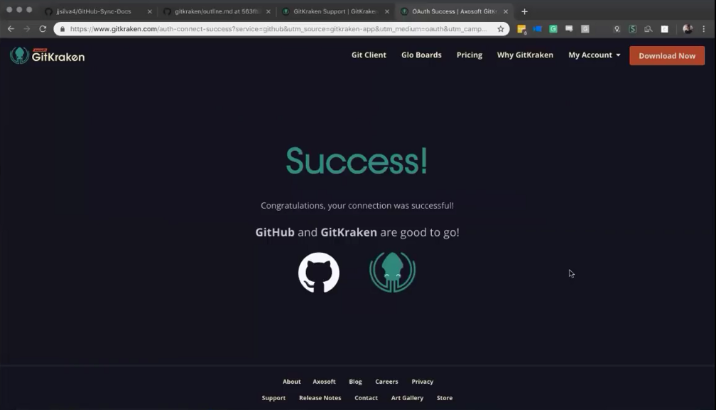

Slide 31
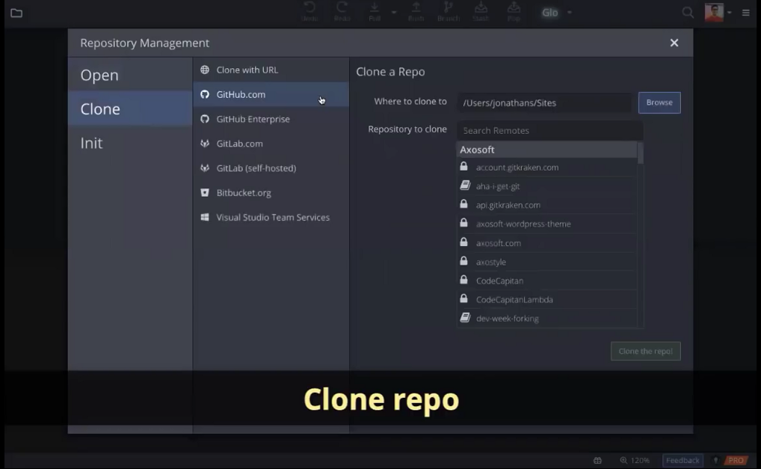

Slide 32
